Slide 1
Eat pizza – drink brus we will start ~17:45
pick up your kits before that
(and pay for the training)

Slide 2
(AVR) Microcontroller Basics
Egil Rotevatn with Snorre Vestli, Amund Aune and Runar Sivertsen
28.03.2022
Notes:
Does anyone want me to do today’s presentation in English? Let me know

Slide 3


µBedpress
Leading Total Systems Solutions Provider:
  High-performance standard and specialized Microcontrollers, Digital Signal Controllers and Microprocessors
  Mixed-Signal, Analog, Interface and Security solutions
  Clock and Timing solutions
  Wireless and Wired Connectivity solutions
  FPGA solutions
  Non-volatile EEPROM and Flash Memory solutions
  Flash IP solutions
$5.3 Billion Revenue FY2020
Headquartered near Phoenix in Chandler, AZ
~18,000
Employees

Slide 4
µBedpress
Power Management
RFICs
MMICs
Encryption
&
Security
DC-DC Converters
Supervisors & Ref.
LDOs, Battery Mgt.
Discretes & Modules
High Voltage
I/Os
Digital
Potentiometer
Precision
Voltage
Reference
Microcontrollers
Microprocessors
FPGA/ SoCs
Motor
Drivers
Sensors
Amplifiers
Filters
A/D
Voice &
Audio
Processing
Power
Drivers
Touch Sensing
Proximity/3D
Buttons/Slider
Touch Screen
Timing
Oscillators
Clock Generators
Clock Buffers
Network Synch.
Memory
EEPROM
Serial Flash
Serial SRAM
Serial EERAM
D/A
LED
Drivers
Smoke Detector
& Piezoelectric
Horn Drivers
Storage
PCIe® Switches
Adapters
Controllers
Optical
Networking
USB
Smart Hubs
Switches
Transceivers
Bridges
Auto/Industrial
Communication
MOST®
Ethernet
INICnetTM
RS232/485
CAN/LIN
Wireless
Wi-Fi®
Bluetooth®
LoRa®
802.15.4
zigbee® /MiWi™
Ethernet
Switches
Controllers
EtherCAT®
PHYs
PoE

Slide 5

µBedpress
Trondheim, Norway
Saskatoon, Canada
Gothenburg, Sweden
Calgary, Canada
Whiteley, UK
Heilbronn & Karlsruhe, Germany
Burnaby, Canada
Ottawa, Canada
Montreal, Canada
Lausanne, Switzerland
Budapest, Hungary
Toronto, Canada
Nantes & Rousset. France
Bucharest, Romania
San Jose , CA
Norristown, PA
Hauppauge, NY
Zaragoza, Spain
Irvine/San Diego, CA
Austin, TX
Shanghai, China
Chandler, AZ
Shenzhen, China
Hsinchu, Taiwan
Bangalore & Chennai, India
Manila, Philippines
Bangkok, Thailand
Ho Chi Minh City, Vietnam
Penang, Malaysia
Brisbane, Australia

Slide 6
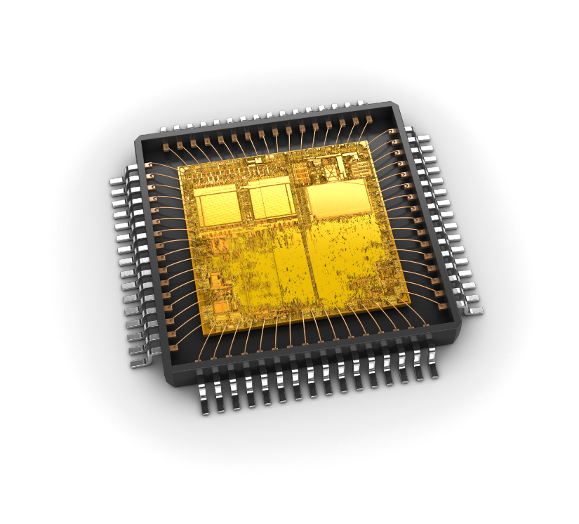
µBedpress
Microchip Technology Norway AS
  ~130 employees
  Located at Lyngården, Moholt
  Design, Test, Tools, Applications, Marketing
    8-bit Microcontrollers – AVR
    Human-Machine Interface – maXTouch
    Tools, Microchip Studio, MPLAB X IDE, Code composers

Slide 7

Microchip 2.0
Be The Very Best Embedded Control Solutions Company Ever

Slide 8
Annual Net Sales Growth
End Market Demand
120 consecutive quarters of profitability!
$ Million

Slide 9
Worldwide 8-Bit Microcontroller Market Share
No. | 1991 Rank | 1996 Rank | 2001 Rank | 2005 Rank | 2006-2009 Rank | 2010 Rank | 2014-2017 Rank | 2017-2020 Rank
1 | Motorola | Motorola | Motorola | Motorola | Microchip | Renesas | Microchip | Microchip
2 | Intel | NEC | Hitachi | Renesas | NEC | Microchip | NXP | NXP
3 | Philips | Philips | NEC | Microchip | STMicro | Atmel | Renesas | Renesas
4 | Mitsubishi | Hitachi | Microchip | NEC | Freescale | STMicro | STMicro | STMicro
5 | NEC | Mitsubishi | STMicro | STMicro | Atmel | Samsung | CEC Huada | Others
6 | Hitachi | Toshiba | Philips | Atmel | Renesas | Freescale | Cypress
7 | Toshiba | Matsushita | Toshiba | Toshiba | NXP | NXP | Si Labs
8 | Siemens | SGS-Thomson | Atmel | Philips | Cypress | Cypress | Datang
9 | TI | Intel | Matsushita | Fujitsu | Sony | Panasonic | SH Fudan
10 | Matsushita | Microchip | Sanyo | Infineon | Fujitsu | Fujitsu | Holtek
11 | National | Siemens | Samsung | Sanyo | Panasonic | Detang | Unigroup
12 | SGS-Thomson | Fujitsu | Mitsubishi | Samsung | Toshiba | NEC (1Q) | Panasonic
13 | Ricoh | TI | Infineon | Matsushita | Samsung | Sony | Nationz
14 | MHS | Sony | Sony | Sony | Datang | Toshiba | ABOV
15 | IIT | Zilog | TI | Sunplus | SI Labs | SI Labs | Ixys
16 | Sharp | Sharp | Fujitsu | Micronas | Holtek | JSC | Toshiba
17 | Fujitsu | Temic | Sunplus | Novatek | Infineon | Holtek | Sony
18 | Oki | Sanyo | Zilong | Intel | Elan | Infineon | On Semi
19 | Zilog | National | Novatek | Holtek | Winbond | Sonix | Sonix
20 | Sony | Oki | Micronas | Winbond | Denso | Elan | HZ Silan
23 | Microchip
Based on dollar shipment volume 1991-2020, Source: Gartner and Microchip
9

Slide 10
Worldwide Microcontroller Market Share
No. | 1991 Rank | 1996 Rank | 2003 Rank | 2008 Rank | 2009 Rank | 2014 Rank | 2019 Rank | 2020 Rank
1 | Motorola | Motorola | Renesas | Renesas | Renesas | Renesas | Renesas | Renesas
2 | Intel | NEC | Motorola | NEC | NEC | Freescale | NXP | NXP
3 | Philips | Philips | NEC | Freescale | Freescale | ST-Micro | Microchip | Microchip
4 | Mitsubishi | Hitachi | Matsushita | Infineon | Samsung | Microchip | ST-Micro | ST-Micro
5 | NEC | Mitsubishi | Infineon | Samsung | Microchip | NXP | Infineon | Infineon
6 | Hitachi | Toshiba | Fujitsu | Microchip | TI | TI | TI | TI
7 | Toshiba | Matsushita | Toshiba | ST-Micro | Infineon | Infineon | Others | Others
8 | Siemens | SGS-Thom | Microchip | TI | St-Micro | Atmel
9 | TI | Intel | Samsung | Fujitsu | Fujitsu | Spansion
10 | Matsushita | Microchip | ST-Micro | NXP | NXP | Samsung
23 | Microchip
9.0%
3.6%
7.5%
1991 &1996 data extrapolated from 8-bit MCU: Source: Gartner and Microchip
10

Slide 11
Analog & Interface Products
LINEAR
POWER MANAGEMENT
MIXED SIGNAL
Amplifiers
DC/DC Converters
Motor Drivers
A/D Converters
Comparators
PWM Controllers
System Supervisors
Voltage Detectors
Current/DC Power
Measurement ICs
INTERFACE
Battery Chargers
Power Switches
Power Monitoring & Metering
Power Modules
Hot Swap Power Controllers
DACs & Digital Potentiometers
CAN, CAN FD, LIN
Power MOSFET Drivers
DDR & SCSI Terminators
Voltage References
HV Interface
Power MOSFETs
Display/LED Drivers
SAFETY AND SECURITY
USB and I/O Expanders
THERMAL MANAGEMENT
CLOCK AND TIMING
Smoke Detector ICs
Ethernet
Wireless
Temperature Sensors
Oscillators
Piezoelectric Horn Drivers
High-Speed Data/Video
Fan Control & Management
Clock Generators
ULTRASOUND
Real-Time Clock/Calendar
Clock Buffers
Ultrasound Products
Network Synchronization

Slide 12


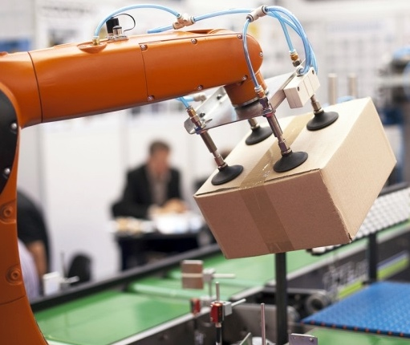
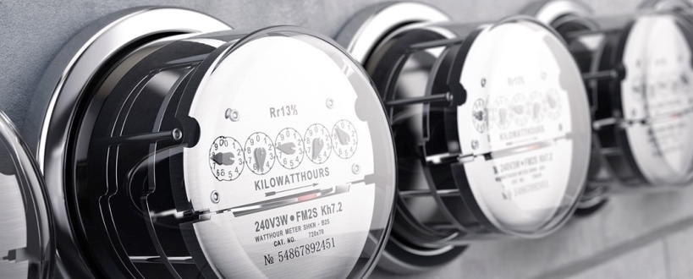
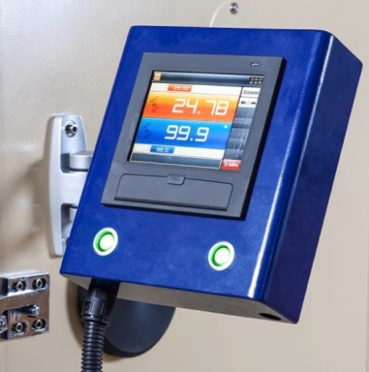

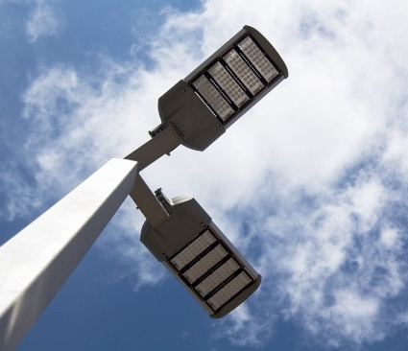
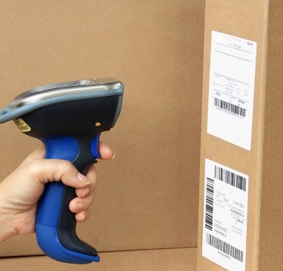
Industrial
28% of Sales

Slide 13


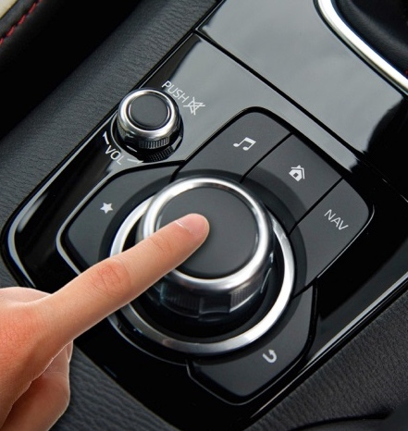
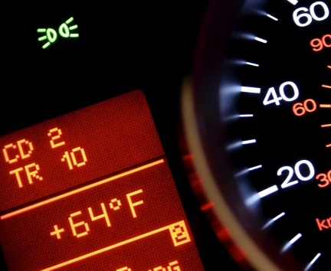

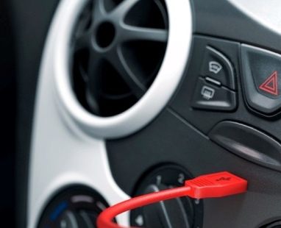
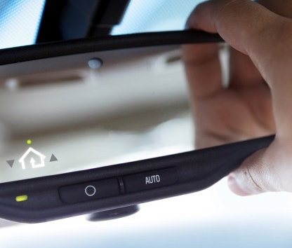
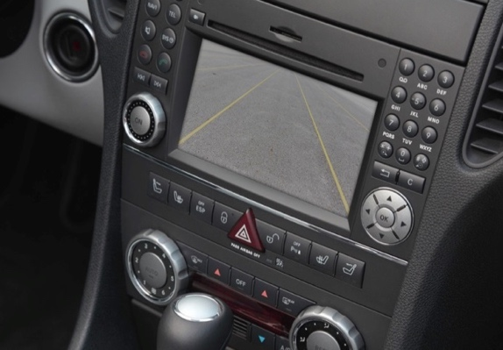
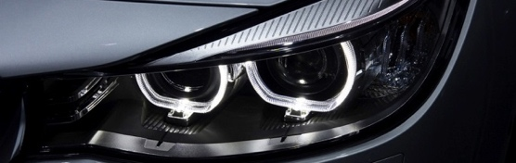
Automotive
15% of Sales

Slide 14

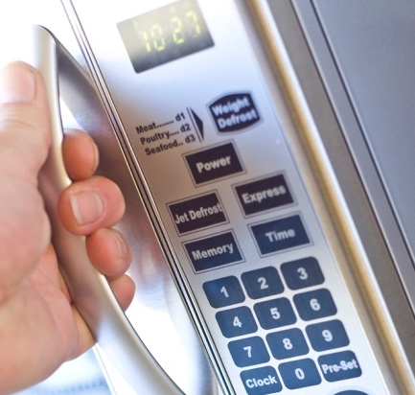
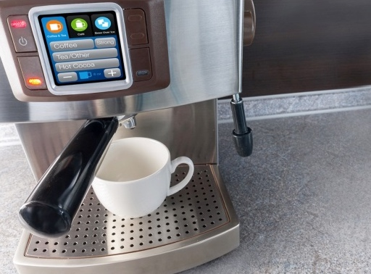

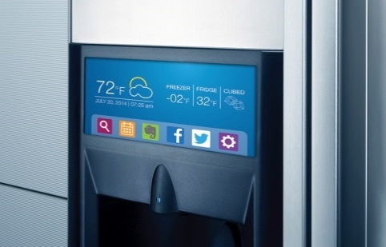
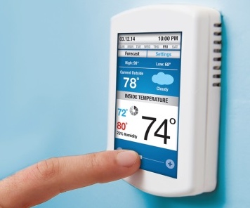
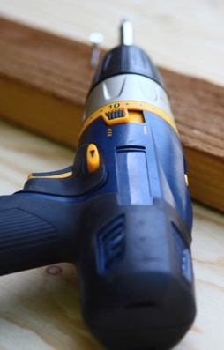

Consumer
13% of Sales

Slide 15



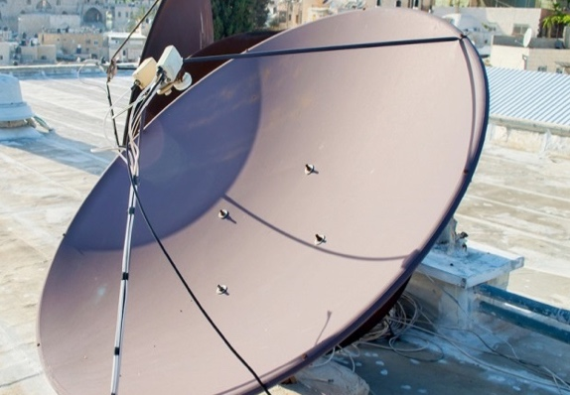

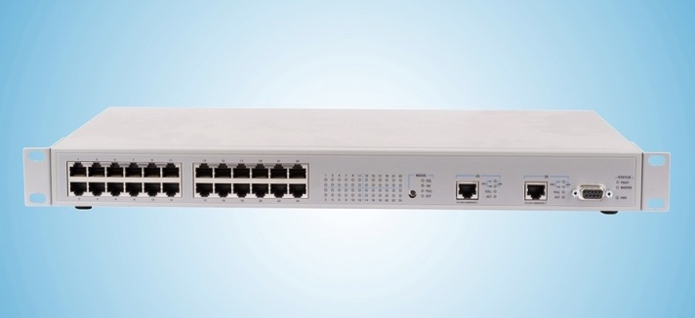
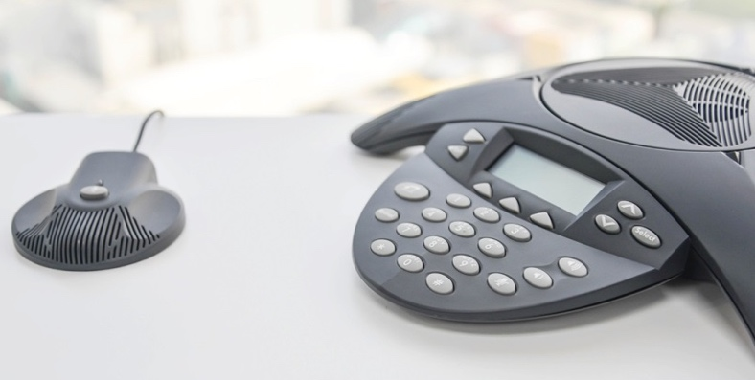
Communications
14% of Sales

Slide 16

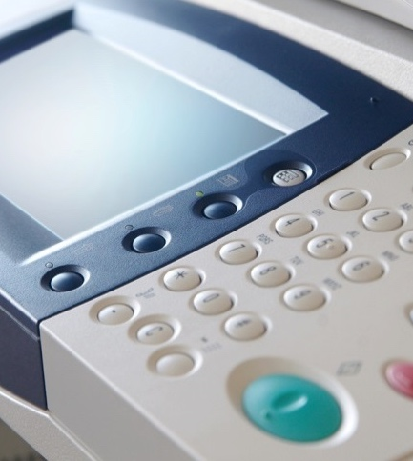




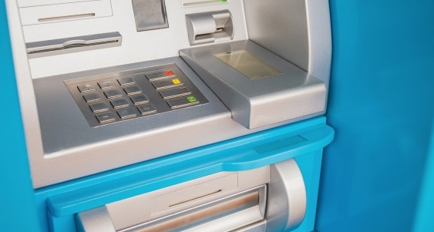
Computing
18% of Sales

Slide 17




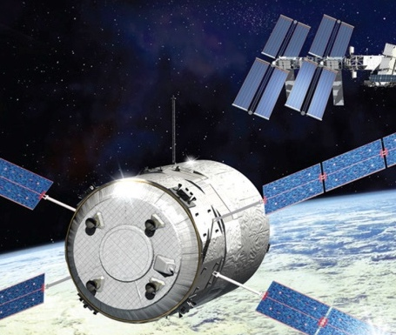
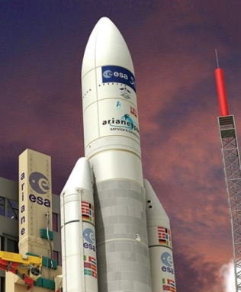


Defense and Aerospace
12% of Sales

Slide 18
Microcontroller
The basics

Slide 19
Basic Parts
A microcontroller must have
  A CPU
  Memory
  I/O controller
I/O Controller
CPU
Memory

Slide 20
The CPU
This is what executes your program
Can do math
Can make decisions based on input
Runs the code stored in memory
I/O Controller
CPU
if (mentor == smart){
printf(“Of course!”);
} else
{
printf(“Lies!”);
}
Memory

Slide 21
Memory
Stores the program
  Read and executed by the CPU
Stores temporary data
  Variables are saved here
Stores static data
  Not deleted when device is turned off
I/O Controller
CPU
Memory

Slide 22
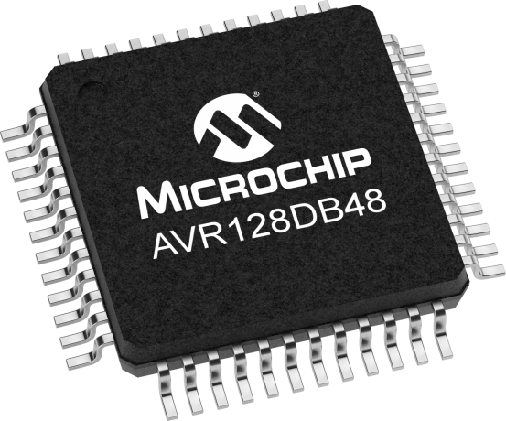
I/O Controller
Pins are used to communicate with the outside world
Controls input/output pins
  Can set pin high or low
  Can read if pin is pulled high or low
  High = V_{DD} = input voltage
  Low = GND = 0V
Some pins can output
or read any voltage
I/O Controller
CPU
Memory

Slide 23
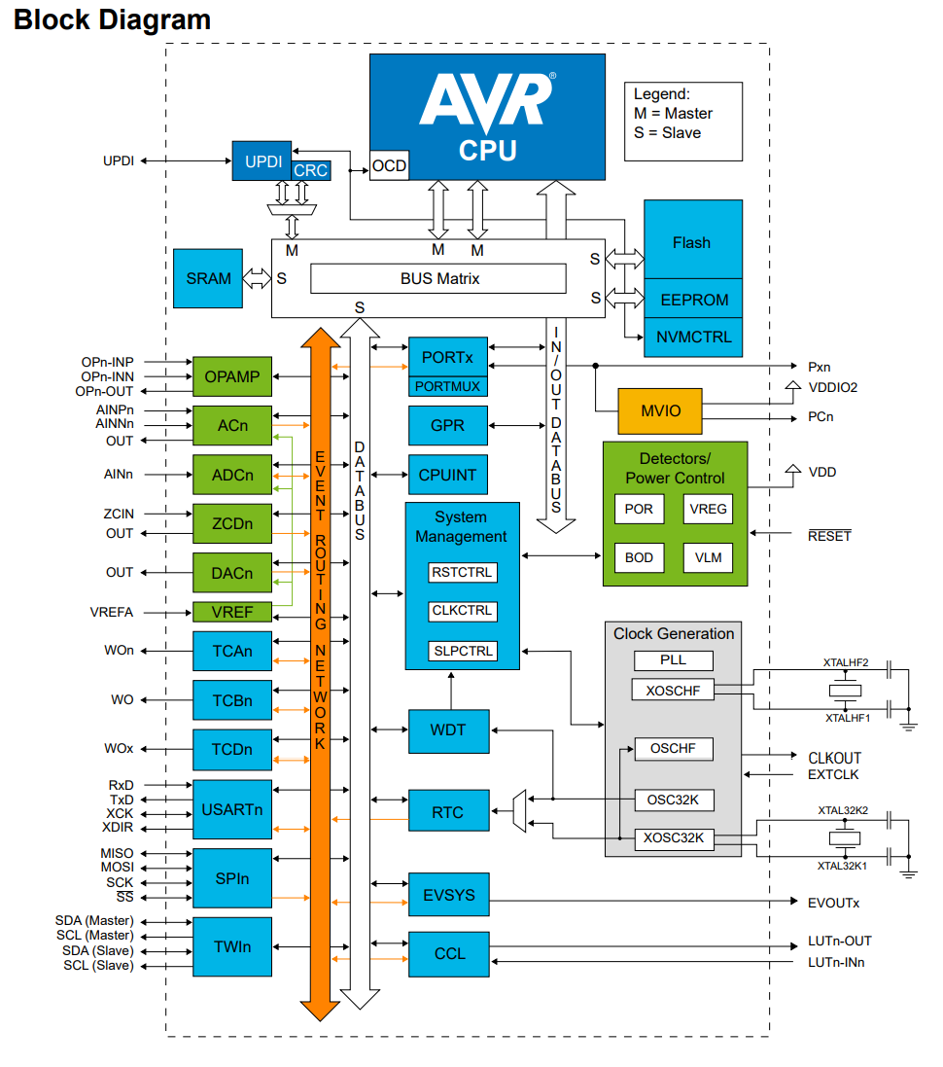
Microcontroller
CPU
It’s that easy!
…Okay, not quite.
Microcontrollers normally have more stuff
  Called Peripherals
  Vary from type to type
  Explained in the Data Sheet
Memory
I/O Control

Slide 24
C
AVR microcontrollers are programmed in C
  Or Assembly for those who like a challenge
  Or other languages someone added support for
C is a hardware-near programming language from the 1970s
Each statement must end with a semicolon;
The program always starts in the main() function
Must be compiled for the AVR architecture

Slide 25
C
#define F_CPU 3333333UL
#include <avr/io.h>
#include <util/delay.h>
#define LED0PORT PORTF
#define LED0_bp PIN5_bp
int main(void)
{
LED0PORT.DIR |= (1 << LED0_bp);
while (1)
{
LED0PORT.OUT ^= (1 << LED0_bp);
_delay_ms(500);
}
}

Slide 26
Bits & Bytes
1 bit = 0 or 1
8 bits == 1 byte
Representation | bit 7 | bit 6 | bit 5 | bit 4 | bit 3 | bit 2 | bit 1 | bit 0 | Sum
Binary | 1 | 1 | 1 | 1 | 1 | 1 | 1 | 1 | 0b11111111
Decimal | 128 | 64 | 32 | 16 | 8 | 4 | 2 | 1 | 255
Hexadecimal | F |  |  |  | F |  |  |  | 0xFF

Slide 27
Bits & Bytes
Bitwise OR: (A | B)
Truth table: |  |  |  | Example:
Input |  | Output |  |  | bit 7 | bit 6 | bit 5 | bit 4 | bit 3 | bit 2 | bit 1 | bit 0
0 | 0 | 0 |  | Input A | 1 | 0 | 0 | 0 | 1 | 0 | 1 | 0
0 | 1 | 1 |  | Input B | 1 | 0 | 1 | 1 | 0 | 0 | 1 | 0
1 | 0 | 1 |  | Output | 1 | 0 | 1 | 1 | 1 | 0 | 1 | 0
1 | 1 | 1
Bitwise AND: (A & B)
Truth table: |  |  |  | Example:
Input |  | Output |  |  | bit 7 | bit 6 | bit 5 | bit 4 | bit 3 | bit 2 | bit 1 | bit 0
0 | 0 | 0 |  | Input A | 1 | 0 | 0 | 0 | 1 | 0 | 1 | 0
0 | 1 | 0 |  | Input B | 1 | 0 | 1 | 1 | 0 | 0 | 1 | 0
1 | 0 | 0 |  | Output | 1 | 0 | 0 | 0 | 0 | 0 | 1 | 0
1 | 1 | 1

Slide 28
Bits & Bytes
Bitwise NOT: (~A)
Truth table: |  |  |  | Example:
Input | Output |  |  |  | bit 7 | bit 6 | bit 5 | bit 4 | bit 3 | bit 2 | bit 1 | bit 0
0 | 1 |  |  | Input A | 1 | 0 | 1 | 1 | 1 | 0 | 1 | 0
1 | 0 |  |  | Output | 0 | 1 | 0 | 0 | 0 | 1 | 0 | 1
Bitwise XOR: (A ^ B) - Exclusive OR
Truth table: |  |  |  | Example:
Input |  | Output |  |  | bit 7 | bit 6 | bit 5 | bit 4 | bit 3 | bit 2 | bit 1 | bit 0
0 | 0 | 0 |  | Input A | 1 | 0 | 1 | 1 | 1 | 0 | 1 | 0
0 | 1 | 1 |  | Input B | 1 | 0 | 0 | 0 | 1 | 0 | 1 | 0
1 | 0 | 1 |  | Output | 0 | 0 | 1 | 1 | 0 | 0 | 0 | 0
1 | 1 | 0

Slide 29
Bits & Bytes
Left shifting: Multiply with 2^{n}
Operation | bit 9 | bit 8 | bit 7 | bit 6 | bit 5 | bit 4 | bit 3 | bit 2 | bit 1 | bit 0 | bit -1 | bit -2 | Decimal
Start value |  |  | 0 | 0 | 0 | 0 | 0 | 0 | 1 | 1 |  |  | 3
Left shift 1
Left shift 2
Left shift 3
Left shift 4
Left shift 5
Left shift 6
Left shift 7
Left shift 8
Right shifting: Divide by 2^{n}
Operation | bit 9 | bit 8 | bit 7 | bit 6 | bit 5 | bit 4 | bit 3 | bit 2 | bit 1 | bit 0 | bit -1 | bit -2 | Decimal
Start value |  |  | 1 | 0 | 1 | 0 | 0 | 0 | 0 | 0 |  |  | 160
Right shift 1
Right shift 2
Right shift 3
Right shift 4
Right shift 5
Right shift 6
Right shift 7
Right shift 8

Slide 30
Bits & Bytes
Left shifting: Multiply with 2^{n}
Operation | bit 9 | bit 8 | bit 7 | bit 6 | bit 5 | bit 4 | bit 3 | bit 2 | bit 1 | bit 0 | bit -1 | bit -2 | Decimal
Start value |  |  | 0 | 0 | 0 | 0 | 0 | 0 | 1 | 1 |  |  | 3
Left shift 1 |  |  | 0 | 0 | 0 | 0 | 0 | 1 | 1 | 0 |  |  | 6
Left shift 2
Left shift 3
Left shift 4
Left shift 5
Left shift 6
Left shift 7
Left shift 8
Right shifting: Divide by 2^{n}
Operation | bit 9 | bit 8 | bit 7 | bit 6 | bit 5 | bit 4 | bit 3 | bit 2 | bit 1 | bit 0 | bit -1 | bit -2 | Decimal
Start value |  |  | 1 | 0 | 1 | 0 | 0 | 0 | 0 | 0 |  |  | 160
Right shift 1
Right shift 2
Right shift 3
Right shift 4
Right shift 5
Right shift 6
Right shift 7
Right shift 8

Slide 31
Bits & Bytes
Left shifting: Multiply with 2^{n}
Operation | bit 9 | bit 8 | bit 7 | bit 6 | bit 5 | bit 4 | bit 3 | bit 2 | bit 1 | bit 0 | bit -1 | bit -2 | Decimal
Start value |  |  | 0 | 0 | 0 | 0 | 0 | 0 | 1 | 1 |  |  | 3
Left shift 1 |  |  | 0 | 0 | 0 | 0 | 0 | 1 | 1 | 0 |  |  | 6
Left shift 2 |  |  | 0 | 0 | 0 | 0 | 1 | 1 | 0 | 0 |  |  | 12
Left shift 3
Left shift 4
Left shift 5
Left shift 6
Left shift 7
Left shift 8
Right shifting: Divide by 2^{n}
Operation | bit 9 | bit 8 | bit 7 | bit 6 | bit 5 | bit 4 | bit 3 | bit 2 | bit 1 | bit 0 | bit -1 | bit -2 | Decimal
Start value |  |  | 1 | 0 | 1 | 0 | 0 | 0 | 0 | 0 |  |  | 160
Right shift 1
Right shift 2
Right shift 3
Right shift 4
Right shift 5
Right shift 6
Right shift 7
Right shift 8

Slide 32
Bits & Bytes
Left shifting: Multiply with 2^{n}
Operation | bit 9 | bit 8 | bit 7 | bit 6 | bit 5 | bit 4 | bit 3 | bit 2 | bit 1 | bit 0 | bit -1 | bit -2 | Decimal
Start value |  |  | 0 | 0 | 0 | 0 | 0 | 0 | 1 | 1 |  |  | 3
Left shift 1 |  |  | 0 | 0 | 0 | 0 | 0 | 1 | 1 | 0 |  |  | 6
Left shift 2 |  |  | 0 | 0 | 0 | 0 | 1 | 1 | 0 | 0 |  |  | 12
Left shift 3 |  |  | 0 | 0 | 0 | 1 | 1 | 0 | 0 | 0 |  |  | 24
Left shift 4 |  |  | 0 | 0 | 1 | 1 | 0 | 0 | 0 | 0 |  |  | 48
Left shift 5 |  |  | 0 | 1 | 1 | 0 | 0 | 0 | 0 | 0 |  |  | 96
Left shift 6 |  |  | 1 | 1 | 0 | 0 | 0 | 0 | 0 | 0 |  |  | 192
Left shift 7
Left shift 8
Right shifting: Divide by 2^{n}
Operation | bit 9 | bit 8 | bit 7 | bit 6 | bit 5 | bit 4 | bit 3 | bit 2 | bit 1 | bit 0 | bit -1 | bit -2 | Decimal
Start value |  |  | 1 | 0 | 1 | 0 | 0 | 0 | 0 | 0 |  |  | 160
Right shift 1
Right shift 2
Right shift 3
Right shift 4
Right shift 5
Right shift 6
Right shift 7
Right shift 8

Slide 33
Bits & Bytes
Left shifting: Multiply with 2^{n}
Operation | bit 9 | bit 8 | bit 7 | bit 6 | bit 5 | bit 4 | bit 3 | bit 2 | bit 1 | bit 0 | bit -1 | bit -2 | Decimal
Start value |  |  | 0 | 0 | 0 | 0 | 0 | 0 | 1 | 1 |  |  | 3
Left shift 1 |  |  | 0 | 0 | 0 | 0 | 0 | 1 | 1 | 0 |  |  | 6
Left shift 2 |  |  | 0 | 0 | 0 | 0 | 1 | 1 | 0 | 0 |  |  | 12
Left shift 3 |  |  | 0 | 0 | 0 | 1 | 1 | 0 | 0 | 0 |  |  | 24
Left shift 4 |  |  | 0 | 0 | 1 | 1 | 0 | 0 | 0 | 0 |  |  | 48
Left shift 5 |  |  | 0 | 1 | 1 | 0 | 0 | 0 | 0 | 0 |  |  | 96
Left shift 6 |  |  | 1 | 1 | 0 | 0 | 0 | 0 | 0 | 0 |  |  | 192
Left shift 7 |  | 1 | 1 | 0 | 0 | 0 | 0 | 0 | 0 | 0 |  |  | 128
Left shift 8
Right shifting: Divide by 2^{n}
Operation | bit 9 | bit 8 | bit 7 | bit 6 | bit 5 | bit 4 | bit 3 | bit 2 | bit 1 | bit 0 | bit -1 | bit -2 | Decimal
Start value |  |  | 1 | 0 | 1 | 0 | 0 | 0 | 0 | 0 |  |  | 160
Right shift 1
Right shift 2
Right shift 3
Right shift 4
Right shift 5
Right shift 6
Right shift 7
Right shift 8

Slide 34
Bits & Bytes
Left shifting: Multiply with 2^{n}
Operation | bit 9 | bit 8 | bit 7 | bit 6 | bit 5 | bit 4 | bit 3 | bit 2 | bit 1 | bit 0 | bit -1 | bit -2 | Decimal
Start value |  |  | 0 | 0 | 0 | 0 | 0 | 0 | 1 | 1 |  |  | 3
Left shift 1 |  |  | 0 | 0 | 0 | 0 | 0 | 1 | 1 | 0 |  |  | 6
Left shift 2 |  |  | 0 | 0 | 0 | 0 | 1 | 1 | 0 | 0 |  |  | 12
Left shift 3 |  |  | 0 | 0 | 0 | 1 | 1 | 0 | 0 | 0 |  |  | 24
Left shift 4 |  |  | 0 | 0 | 1 | 1 | 0 | 0 | 0 | 0 |  |  | 48
Left shift 5 |  |  | 0 | 1 | 1 | 0 | 0 | 0 | 0 | 0 |  |  | 96
Left shift 6 |  |  | 1 | 1 | 0 | 0 | 0 | 0 | 0 | 0 |  |  | 192
Left shift 7 |  | 1 | 1 | 0 | 0 | 0 | 0 | 0 | 0 | 0 |  |  | 128
Left shift 8 | 1 | 1 | 0 | 0 | 0 | 0 | 0 | 0 | 0 | 0 |  |  | 0
Right shifting: Divide by 2^{n}
Operation | bit 9 | bit 8 | bit 7 | bit 6 | bit 5 | bit 4 | bit 3 | bit 2 | bit 1 | bit 0 | bit -1 | bit -2 | Decimal
Start value |  |  | 1 | 0 | 1 | 0 | 0 | 0 | 0 | 0 |  |  | 160
Right shift 1
Right shift 2
Right shift 3
Right shift 4
Right shift 5
Right shift 6
Right shift 7
Right shift 8

Slide 35
Bits & Bytes
Left shifting: Multiply with 2^{n}
Operation | bit 9 | bit 8 | bit 7 | bit 6 | bit 5 | bit 4 | bit 3 | bit 2 | bit 1 | bit 0 | bit -1 | bit -2 | Decimal
Start value |  |  | 0 | 0 | 0 | 0 | 0 | 0 | 1 | 1 |  |  | 3
Left shift 1 |  |  | 0 | 0 | 0 | 0 | 0 | 1 | 1 | 0 |  |  | 6
Left shift 2 |  |  | 0 | 0 | 0 | 0 | 1 | 1 | 0 | 0 |  |  | 12
Left shift 3 |  |  | 0 | 0 | 0 | 1 | 1 | 0 | 0 | 0 |  |  | 24
Left shift 4 |  |  | 0 | 0 | 1 | 1 | 0 | 0 | 0 | 0 |  |  | 48
Left shift 5 |  |  | 0 | 1 | 1 | 0 | 0 | 0 | 0 | 0 |  |  | 96
Left shift 6 |  |  | 1 | 1 | 0 | 0 | 0 | 0 | 0 | 0 |  |  | 192
Left shift 7 |  | 1 | 1 | 0 | 0 | 0 | 0 | 0 | 0 | 0 |  |  | 128
Left shift 8 | 1 | 1 | 0 | 0 | 0 | 0 | 0 | 0 | 0 | 0 |  |  | 0
Right shifting: Divide by 2^{n}
Operation | bit 9 | bit 8 | bit 7 | bit 6 | bit 5 | bit 4 | bit 3 | bit 2 | bit 1 | bit 0 | bit -1 | bit -2 | Decimal
Start value |  |  | 1 | 0 | 1 | 0 | 0 | 0 | 0 | 0 |  |  | 160
Right shift 1 |  |  | 0 | 1 | 0 | 1 | 0 | 0 | 0 | 0 |  |  | 80
Right shift 2 |  |  | 0 | 0 | 1 | 0 | 1 | 0 | 0 | 0 |  |  | 40
Right shift 3 |  |  | 0 | 0 | 0 | 1 | 0 | 1 | 0 | 0 |  |  | 20
Right shift 4 |  |  | 0 | 0 | 0 | 0 | 1 | 0 | 1 | 0 |  |  | 10
Right shift 5 |  |  | 0 | 0 | 0 | 0 | 0 | 1 | 0 | 1 |  |  | 5
Right shift 6 |  |  | 0 | 0 | 0 | 0 | 0 | 0 | 1 | 0 | 1 |  | 2
Right shift 7 |  |  | 0 | 0 | 0 | 0 | 0 | 0 | 0 | 1 | 0 | 1 | 1
Right shift 8 |  |  | 0 | 0 | 0 | 0 | 0 | 0 | 0 | 0 | 1 | 0 | 0

Slide 36
Bits & Bytes
Left shifting: Multiply with 2^{n}
Operation | bit 9 | bit 8 | bit 7 | bit 6 | bit 5 | bit 4 | bit 3 | bit 2 | bit 1 | bit 0 | bit -1 | bit -2 | Decimal
(A << 0) |  |  | 0 | 0 | 0 | 0 | 0 | 0 | 1 | 1 |  |  | 3
(A << 1) |  |  | 0 | 0 | 0 | 0 | 0 | 1 | 1 | 0 |  |  | 6
(A << 2) |  |  | 0 | 0 | 0 | 0 | 1 | 1 | 0 | 0 |  |  | 12
(A << 3) |  |  | 0 | 0 | 0 | 1 | 1 | 0 | 0 | 0 |  |  | 24
(A << 4) |  |  | 0 | 0 | 1 | 1 | 0 | 0 | 0 | 0 |  |  | 48
(A << 5) |  |  | 0 | 1 | 1 | 0 | 0 | 0 | 0 | 0 |  |  | 96
(A << 6) |  |  | 1 | 1 | 0 | 0 | 0 | 0 | 0 | 0 |  |  | 192
(A << 7) |  |  | 1 | 0 | 0 | 0 | 0 | 0 | 0 | 0 |  |  | 128
(A << 8) |  |  | 0 | 0 | 0 | 0 | 0 | 0 | 0 | 0 |  |  | 0
Right shifting: Divide by 2^{n}
Operation | bit 9 | bit 8 | bit 7 | bit 6 | bit 5 | bit 4 | bit 3 | bit 2 | bit 1 | bit 0 | bit -1 | bit -2 | Decimal
(A >> 0) |  |  | 1 | 0 | 1 | 0 | 0 | 0 | 0 | 0 |  |  | 160
(A >> 1) |  |  | 0 | 1 | 0 | 1 | 0 | 0 | 0 | 0 |  |  | 80
(A >> 2) |  |  | 0 | 0 | 1 | 0 | 1 | 0 | 0 | 0 |  |  | 40
(A >> 3) |  |  | 0 | 0 | 0 | 1 | 0 | 1 | 0 | 0 |  |  | 20
(A >> 4) |  |  | 0 | 0 | 0 | 0 | 1 | 0 | 1 | 0 |  |  | 10
(A >> 5) |  |  | 0 | 0 | 0 | 0 | 0 | 1 | 0 | 1 |  |  | 5
(A >> 6) |  |  | 0 | 0 | 0 | 0 | 0 | 0 | 1 | 0 |  |  | 2
(A >> 7) |  |  | 0 | 0 | 0 | 0 | 0 | 0 | 0 | 1 |  |  | 1
(A >> 8) |  |  | 0 | 0 | 0 | 0 | 0 | 0 | 0 | 0 |  |  | 0

Slide 37
Bitmask
A defined left-shifted bit or bits
Think bit positions, not values
  (1 << 3) is read as «Write ‘1’ to bit 3»
  You configure a bit, not writing a number
Bitmasks can be combined
  (1 << 3) | (1 << 6)
  is «Write ‘1’ to bits 3 and 6»
Zero-indexed
  (1 << 0) the first bit is bit 0.

Slide 38
Bits & Bytes
Logical operators != bitwise operators
Logical NOT: (!A) |  |  |  | Logical OR: (A || B) |  |  |  | Logical AND: (A && B)
Truth table: |  |  |  | Truth table: |  |  |  | Truth table:
Input |  | Output |  | Input |  | Output |  | Input |  | Output
0 |  | 1 |  | 0 | 0 | 0 |  | 0 | 0 | 0
<0 |  | 0 |  | 0 | ≠0 | 1 |  | 0 | ≠0 | 0
>0 |  | 0 |  | ≠0 | 0 | 1 |  | ≠0 | 0 | 0
 |  |  |  | ≠0 | ≠0 | 1 |  | ≠0 | ≠0 | 1

Slide 39
Bits & Bytes
Logical operators != bitwise operators
Relational operators
0 == «False» 1 == «True»
Operator | Meaning of Operator | Example
== | Equal to | 5 == 3 evaluates to 0
> | Greater than | 5 > 3 evaluates to 1
< | Less than | 5 < 3 evaluates to 0
!= | Not equal to | 5 != 3 evaluates to 1
>= | Greater than or equal to | 5 >= 3 evaluates to 1
<= | Less than or equal to | 5 <= 3 evaluates to 0

Slide 40
Bit-fu 1st Dan
Syntax | Operation
A + B | Add A and B
A - B | Substract B from A
A / B | Divide A by B
A * B | Multiply A with B
~A | Bitwise NOT
A & B | Bitwise AND
A | B | Bitwise OR
A ^ B | Bitwise XOR
A >> n | Right shift A bitwise n bits
A << n | Left shift A bitwise n bits
A || B | Logical OR
A && B | Logical AND
!A | Logical NOT
A == B | Equal to
A > B | Greater than
A < B | Less than
A != B | Not equal to
A >= B | Greater than or equal to
A <= B | Less than or equal to

Slide 41

Pause? – 10 min?

Slide 42
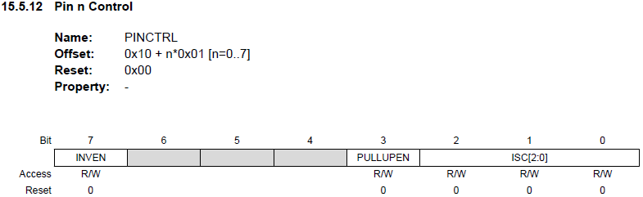
Registers
Special location in RAM
Full of bits linked to module functions
Explained in data sheet and manual

Slide 43
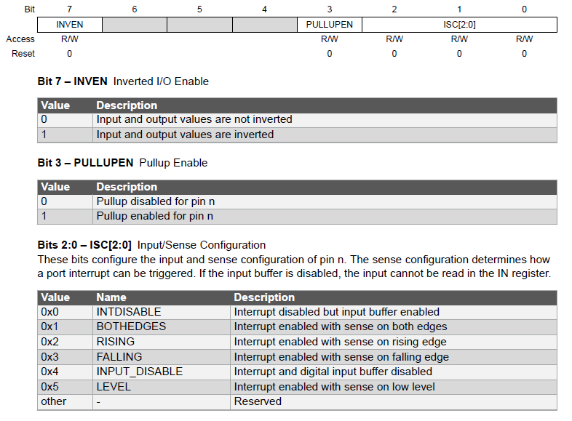
Registers

Slide 44
Registers
Header file contains definitions and names
  #include <avr/io.h>
/* I/O Ports */
typedef struct PORT_struct
{
register8_t DIR; /* Data Direction */
register8_t DIRSET; /* Data Direction Set */
register8_t DIRCLR; /* Data Direction Clear */
register8_t DIRTGL; /* Data Direction Toggle */
register8_t OUT; /* Output Value */
register8_t OUTSET; /* Output Value Set */
register8_t OUTCLR; /* Output Value Clear */
register8_t OUTTGL; /* Output Value Toggle */
register8_t IN; /* Input Value */
register8_t INTFLAGS; /* Interrupt Flags */
register8_t PORTCTRL; /* Port Control */
...
} PORT_t;
#define PORTA (*(PORT_t *) 0x0400) /* I/O Ports */
Notes:
Fancy variables located at special memory location

Slide 45
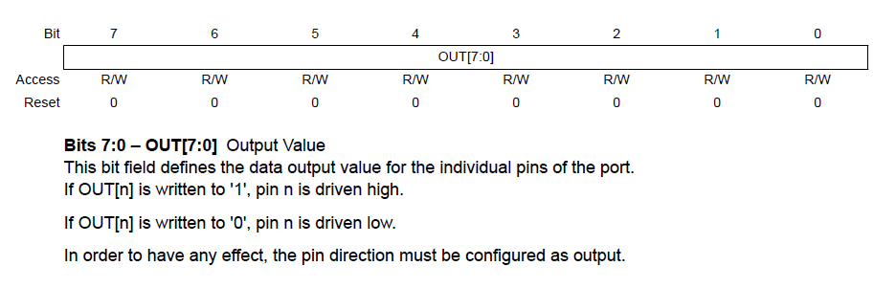
Registers
PORTA.DIR = 0xff; // Set all PORTA pins as output
PORTA.OUT = 0; // Set all PORTA pins low
PORTA.OUT = 12; // You can do this, but only if you want to annoy people
// Better to do it like this:
PORTA.OUT = (1 << PIN3_bp) | (1 << PIN2_bp); // Set pins PA2 and PA3 high
PORTA.PIN1CTRL = (1 << PORT_INVEN_bp); // Invert pin functionality of PA1

Slide 46
Registers
Think bit positions, not values
  You configure bits, not writing a number
Bad examples:
Good examples:
        PORTA.OUT = 8;
        PORTA.OUT = 0b00001000;
        PORTA.OUT = (1 << 3);
        PORTA.OUT = (1 << PIN3_bp);
Notes:
Callback to bitshifting

Slide 47
Bits & Registers
Normal write to register: (A = B)
Operation | bit 7 | bit 6 | bit 5 | bit 4 | bit 3 | bit 2 | bit 1 | bit 0 | Hex
Register value A | 1 | 1 | 1 | 0 | 0 | 0 | 0 | 0 | 0xE0
New value B | 0 | 0 | 1 | 0 | 0 | 0 | 1 | 0 | 0x22
Updated register A
Set bit(s) in register: (A |= B), long form: (A = A | B)
Operation | bit 7 | bit 6 | bit 5 | bit 4 | bit 3 | bit 2 | bit 1 | bit 0 | Hex
Register value A
New value B
Updated register A

Slide 48
Bits & Registers
Normal write to register: (A = B)
Operation | bit 7 | bit 6 | bit 5 | bit 4 | bit 3 | bit 2 | bit 1 | bit 0 | Hex
Register value A | x | x | x | x | x | x | x | x
New value B | 0 | 0 | 1 | 0 | 0 | 0 | 1 | 0 | 0x22
Updated register A | 0 | 0 | 1 | 0 | 0 | 0 | 1 | 0 | 0x22
Set bit(s) in register: (A |= B), long form: (A = A | B)
Operation | bit 7 | bit 6 | bit 5 | bit 4 | bit 3 | bit 2 | bit 1 | bit 0 | Hex
Register value A
New value B
Updated register A

Slide 49
Bits & Registers
Normal write to register: (A = B)
Operation | bit 7 | bit 6 | bit 5 | bit 4 | bit 3 | bit 2 | bit 1 | bit 0 | Hex
Register value A | x | x | x | x | x | x | x | x
New value B | 0 | 0 | 1 | 0 | 0 | 0 | 1 | 0 | 0x22
Updated register A | 0 | 0 | 1 | 0 | 0 | 0 | 1 | 0 | 0x22
Set bit(s) in register: (A |= B), long form: (A = A | B)
Operation | bit 7 | bit 6 | bit 5 | bit 4 | bit 3 | bit 2 | bit 1 | bit 0 | Hex
Register value A | 1 | 0 | 1 | 0 | 0 | 1 | 0 | 1 | 0xA5
New value B | 0 | 0 | 1 | 0 | 0 | 0 | 1 | 0 | 0x22
Updated register A

Slide 50
Bits & Registers
Normal write to register: (A = B)
Operation | bit 7 | bit 6 | bit 5 | bit 4 | bit 3 | bit 2 | bit 1 | bit 0 | Hex
Register value A | x | x | x | x | x | x | x | x
New value B | 0 | 0 | 1 | 0 | 0 | 0 | 1 | 0 | 0x22
Updated register A | 0 | 0 | 1 | 0 | 0 | 0 | 1 | 0 | 0x22
Set bit(s) in register: (A |= B), long form: (A = A | B)
Operation | bit 7 | bit 6 | bit 5 | bit 4 | bit 3 | bit 2 | bit 1 | bit 0 | Hex
Register value A | 1 | 0 | 1 | 0 | 0 | 1 | 0 | 1 | 0xA5
New value B | 0 | 0 | 1 | 0 | 0 | 0 | 1 | 0 | 0x22
Updated register A | x | x | 1 | x | x | x | 1 | x

Slide 51
Bits & Registers
Normal write to register: (A = B)
Operation | bit 7 | bit 6 | bit 5 | bit 4 | bit 3 | bit 2 | bit 1 | bit 0 | Hex
Register value A | x | x | x | x | x | x | x | x
New value B | 0 | 0 | 1 | 0 | 0 | 0 | 1 | 0 | 0x22
Updated register A | 0 | 0 | 1 | 0 | 0 | 0 | 1 | 0 | 0x22
Set bit(s) in register: (A |= B), long form: (A = A | B)
Operation | bit 7 | bit 6 | bit 5 | bit 4 | bit 3 | bit 2 | bit 1 | bit 0 | Hex
Register value A | 1 | 0 | 1 | 0 | 0 | 1 | 0 | 1 | 0xA5
New value B | 0 | 0 | 1 | 0 | 0 | 0 | 1 | 0 | 0x22
Updated register A | 1 | 0 | 1 | 0 | 0 | 1 | 1 | 1 | 0xA7

Slide 52
Bits & Registers
Clear bit(s) in register: (A &= ~B), long form: (A = A & ~B)
Operation | bit 7 | bit 6 | bit 5 | bit 4 | bit 3 | bit 2 | bit 1 | bit 0 | Hex
Register value A | 1 | 0 | 1 | 0 | 0 | 1 | 0 | 1 | 0xA5
New value B | 0 | 0 | 1 | 0 | 0 | 0 | 1 | 0 | 0x22
Inverted value B
Updated register A
Toggle bit(s) in register: (A ^= B), long form: (A = A ^ B)
Operation | bit 7 | bit 6 | bit 5 | bit 4 | bit 3 | bit 2 | bit 1 | bit 0 | Hex
Register value A
New value B
Updated register A

Slide 53
Bits & Registers
Clear bit(s) in register: (A &= ~B), long form: (A = A & ~B)
Operation | bit 7 | bit 6 | bit 5 | bit 4 | bit 3 | bit 2 | bit 1 | bit 0 | Hex
Register value A | 1 | 0 | 1 | 0 | 0 | 1 | 0 | 1 | 0xA5
New value B | 0 | 0 | 1 | 0 | 0 | 0 | 1 | 0 | 0x22
Inverted value B | 1 | 1 | 0 | 1 | 1 | 1 | 0 | 1 | 0xDD
Updated register A
Toggle bit(s) in register: (A ^= B), long form: (A = A ^ B)
Operation | bit 7 | bit 6 | bit 5 | bit 4 | bit 3 | bit 2 | bit 1 | bit 0 | Hex
Register value A
New value B
Updated register A

Slide 54
Bits & Registers
Clear bit(s) in register: (A &= ~B), long form: (A = A & ~B)
Operation | bit 7 | bit 6 | bit 5 | bit 4 | bit 3 | bit 2 | bit 1 | bit 0 | Hex
Register value A | 1 | 0 | 1 | 0 | 0 | 1 | 0 | 1 | 0xA5
New value B | 0 | 0 | 1 | 0 | 0 | 0 | 1 | 0 | 0x22
Inverted value B | 1 | 1 | 0 | 1 | 1 | 1 | 0 | 1 | 0xDD
Updated register A | x | x | 0 | x | x | x | 0 | x
Toggle bit(s) in register: (A ^= B), long form: (A = A ^ B)
Operation | bit 7 | bit 6 | bit 5 | bit 4 | bit 3 | bit 2 | bit 1 | bit 0 | Hex
Register value A
New value B
Updated register A

Slide 55
Bits & Registers
Clear bit(s) in register: (A &= ~B), long form: (A = A & ~B)
Operation | bit 7 | bit 6 | bit 5 | bit 4 | bit 3 | bit 2 | bit 1 | bit 0 | Hex
Register value A | 1 | 0 | 1 | 0 | 0 | 1 | 0 | 1 | 0xA5
New value B | 0 | 0 | 1 | 0 | 0 | 0 | 1 | 0 | 0x22
Inverted value B | 1 | 1 | 0 | 1 | 1 | 1 | 0 | 1 | 0xDD
Updated register A | 1 | 0 | 0 | 0 | 0 | 1 | 0 | 1 | 0x85
Toggle bit(s) in register: (A ^= B), long form: (A = A ^ B)
Operation | bit 7 | bit 6 | bit 5 | bit 4 | bit 3 | bit 2 | bit 1 | bit 0 | Hex
Register value A
New value B
Updated register A

Slide 56
Bits & Registers
Clear bit(s) in register: (A &= ~B), long form: (A = A & ~B)
Operation | bit 7 | bit 6 | bit 5 | bit 4 | bit 3 | bit 2 | bit 1 | bit 0 | Hex
Register value A | 1 | 0 | 1 | 0 | 0 | 1 | 0 | 1 | 0xA5
New value B | 0 | 0 | 1 | 0 | 0 | 0 | 1 | 0 | 0x22
Inverted value B | 1 | 1 | 0 | 1 | 1 | 1 | 0 | 1 | 0xDD
Updated register A | 1 | 0 | 0 | 0 | 0 | 1 | 0 | 1 | 0x85
Toggle bit(s) in register: (A ^= B), long form: (A = A ^ B)
Operation | bit 7 | bit 6 | bit 5 | bit 4 | bit 3 | bit 2 | bit 1 | bit 0 | Hex
Register value A | x | x | x | x | x | x | x | x
New value B | 0 | 0 | 1 | 0 | 0 | 0 | 1 | 0 | 0x22
Updated register A

Slide 57
Bits & Registers
Clear bit(s) in register: (A &= ~B), long form: (A = A & ~B)
Operation | bit 7 | bit 6 | bit 5 | bit 4 | bit 3 | bit 2 | bit 1 | bit 0 | Hex
Register value A | 1 | 0 | 1 | 0 | 0 | 1 | 0 | 1 | 0xA5
New value B | 0 | 0 | 1 | 0 | 0 | 0 | 1 | 0 | 0x22
Inverted value B | 1 | 1 | 0 | 1 | 1 | 1 | 0 | 1 | 0xDD
Updated register A | 1 | 0 | 0 | 0 | 0 | 1 | 0 | 1 | 0x85
Toggle bit(s) in register: (A ^= B), long form: (A = A ^ B)
Operation | bit 7 | bit 6 | bit 5 | bit 4 | bit 3 | bit 2 | bit 1 | bit 0 | Hex
Register value A | x | x | x | x | x | x | x | x
New value B | 0 | 0 | 1 | 0 | 0 | 0 | 1 | 0 | 0x22
Updated register A | x | x | ~x | x | x | x | ~x | x
If a bit in B is ‘1’, the corresponding bit in A will be inverted (toggled).
Notes:
A ^= B: Where bit mask is 1, the updated register will change

Slide 58
Bits & Registers
Clear bit(s) in register: (A &= ~B), long form: (A = A & ~B)
Operation | bit 7 | bit 6 | bit 5 | bit 4 | bit 3 | bit 2 | bit 1 | bit 0 | Hex
Register value A | 1 | 0 | 1 | 0 | 0 | 1 | 0 | 1 | 0xA5
New value B | 0 | 0 | 1 | 0 | 0 | 0 | 1 | 0 | 0x22
Inverted value B | 1 | 1 | 0 | 1 | 1 | 1 | 0 | 1 | 0xDD
Updated register A | 1 | 0 | 0 | 0 | 0 | 1 | 0 | 1 | 0x85
Toggle bit(s) in register: (A ^= B), long form: (A = A ^ B)
Operation | bit 7 | bit 6 | bit 5 | bit 4 | bit 3 | bit 2 | bit 1 | bit 0 | Hex
Register value A | 1 | 0 | 1 | 0 | 0 | 1 | 0 | 1 | 0xA5
New value B | 0 | 0 | 1 | 0 | 0 | 0 | 1 | 0 | 0x22
Updated register A | 1 | 0 | 0 | 0 | 0 | 1 | 1 | 1 | 0x87
If a bit in B is ‘1’, the corresponding bit in A will be inverted (toggled).
Notes:
A ^= B: Where bit mask is 1, the updated register will change

Slide 59
Bit-fu 2nd Dan
Syntax | Long Form | Operation
A |= B | A = A | B | A = Bitwise OR of A and B
A &= B | A = A & B | A = Bitwise AND of A and B
A ^= B | A = A ^ B | A = Bitwise XOR of A and B
A &= ~B | A = A & (~B) | A = Bitwise AND of A and NOT B
A += B | A = A + B | A = Add A and B
A -= B | A = A - B | A = Subtract B from A
A *= B | A = A * B | A = Multiply A with B
A /= B | A = A / B | A = Divide A with B
A >>= n | A = A >> n | A = Right shift A n bits
A <<= n | A = A << n | A = Left shift A n bits
A++ | A = A + 1 | A = Add 1 to A (Increment)
A-- | A = A - 1 | A = Subtract 1 from A (Decrement)

Slide 60
Registers
C example
// Start out with pins PA2 and PA3 high
PORTA.OUT = (1 << PIN3_bp) | (1 << PIN2_bp);
// Set PA5 high without changing PA2 and PA3
PORTA.OUT |= (1 << PIN5_bp);
// Set PA2 low without changing PA5 and PA3
PORTA.OUT &= ~(1 << PIN2_bp);
Notes:
Add actual values

Slide 61
Registers
C example
// Start out with pins PA2 and PA3 high
PORTA.OUT = (1 << PIN3_bp) | (1 << PIN2_bp);
// Set PA5 high without changing PA2 and PA3
PORTA.OUT |= (1 << PIN5_bp);
// Set PA2 low without changing PA5 and PA3
PORTA.OUT &= ~(1 << PIN2_bp);
0b00001100
Notes:
Add actual values

Slide 62
Registers
C example
// Start out with pins PA2 and PA3 high
PORTA.OUT = (1 << PIN3_bp) | (1 << PIN2_bp);
// Set PA5 high without changing PA2 and PA3
PORTA.OUT |= (1 << PIN5_bp);
// Set PA2 low without changing PA5 and PA3
PORTA.OUT &= ~(1 << PIN2_bp);
0b00101100
Notes:
Add actual values

Slide 63
Registers
C example
// Start out with pins PA2 and PA3 high
PORTA.OUT = (1 << PIN3_bp) | (1 << PIN2_bp);
// Set PA5 high without changing PA2 and PA3
PORTA.OUT |= (1 << PIN5_bp);
// Set PA2 low without changing PA5 and PA3
PORTA.OUT &= ~(1 << PIN2_bp);
0b00101000
Notes:
Add actual values

Slide 64
Registers
Check if bit(s) are set
In C, everything except 0 is «True»
        if (PORTA.IN & (1 << PIN3_bp) ) {
        // PA3 is high, do something
        }
        if (PORTA.IN & (1 << PIN3_bp) != 0) {
        // PA3 is high, do something
        }

Slide 65
Registers
Check if bit(s) are cleared
Can also be written as compare with 0
        if (!(PORTA.IN & (1 << PIN3_bp))) {
        // PA3 is low, do something
        }
        if (PORTA.IN & (1 << PIN3_bp) == 0) {
        // PA3 is low, do something
        }

Slide 66
Registers
Store the current register state
Check if bit was set, may have changed
        uint8_t my_variable = PORTA.IN;
        if (my_variable & (1 << PIN3_bp)) {
        // PA3 was high, do something
        }

Slide 67
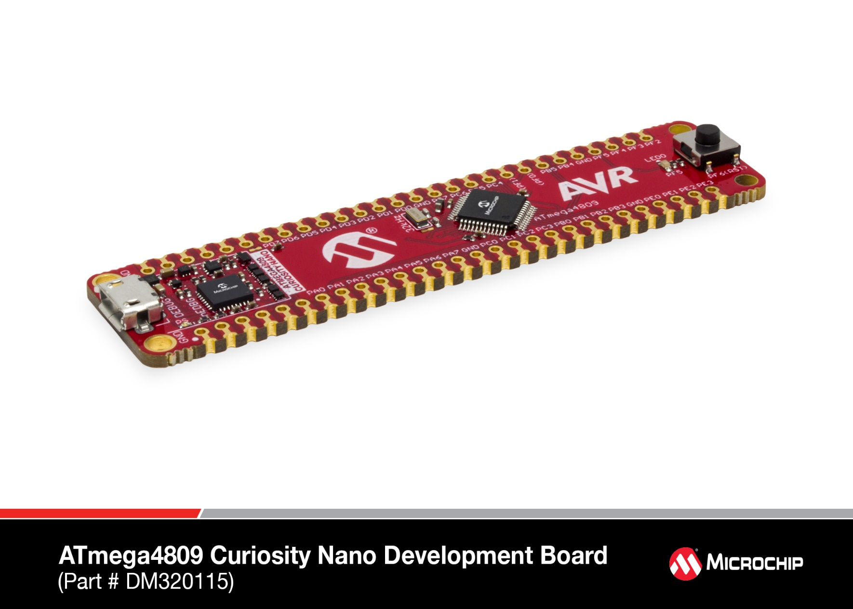
ATmega4809 Curiosity Nano

Slide 68
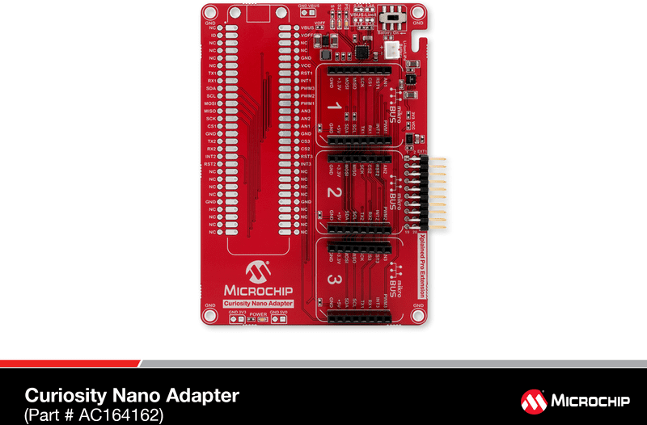
Curiosity Nano Adapter

Slide 69
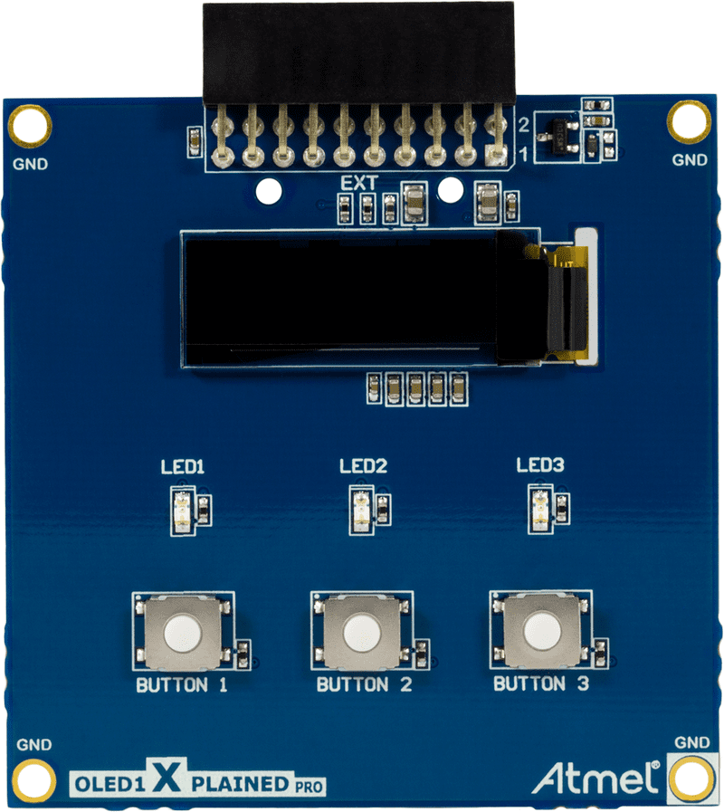
OLED1 Xplained Pro

Slide 70
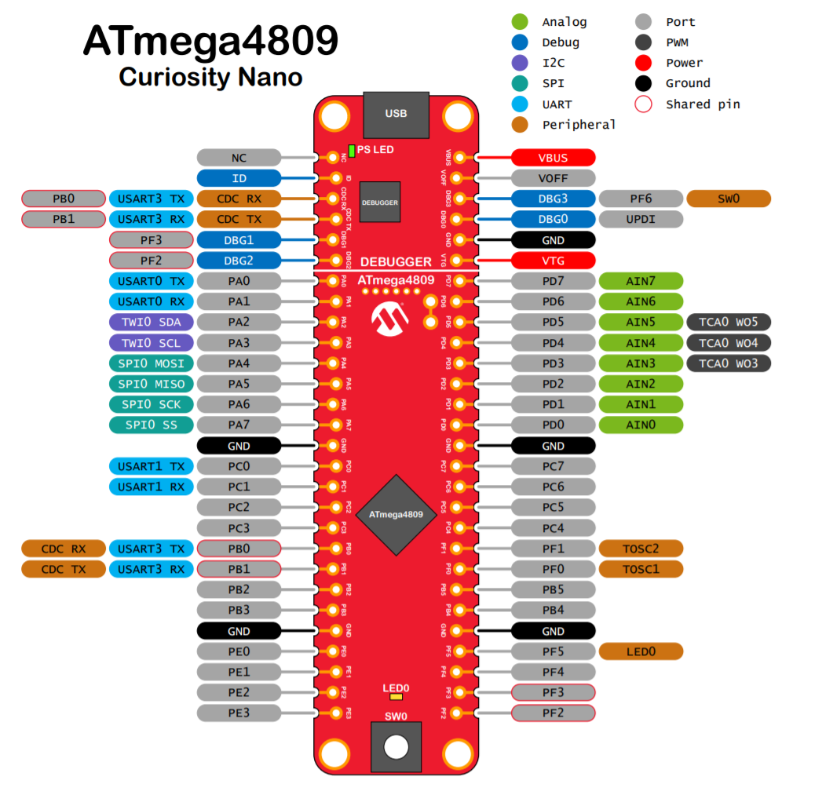
Hardware
User Guide

Slide 71
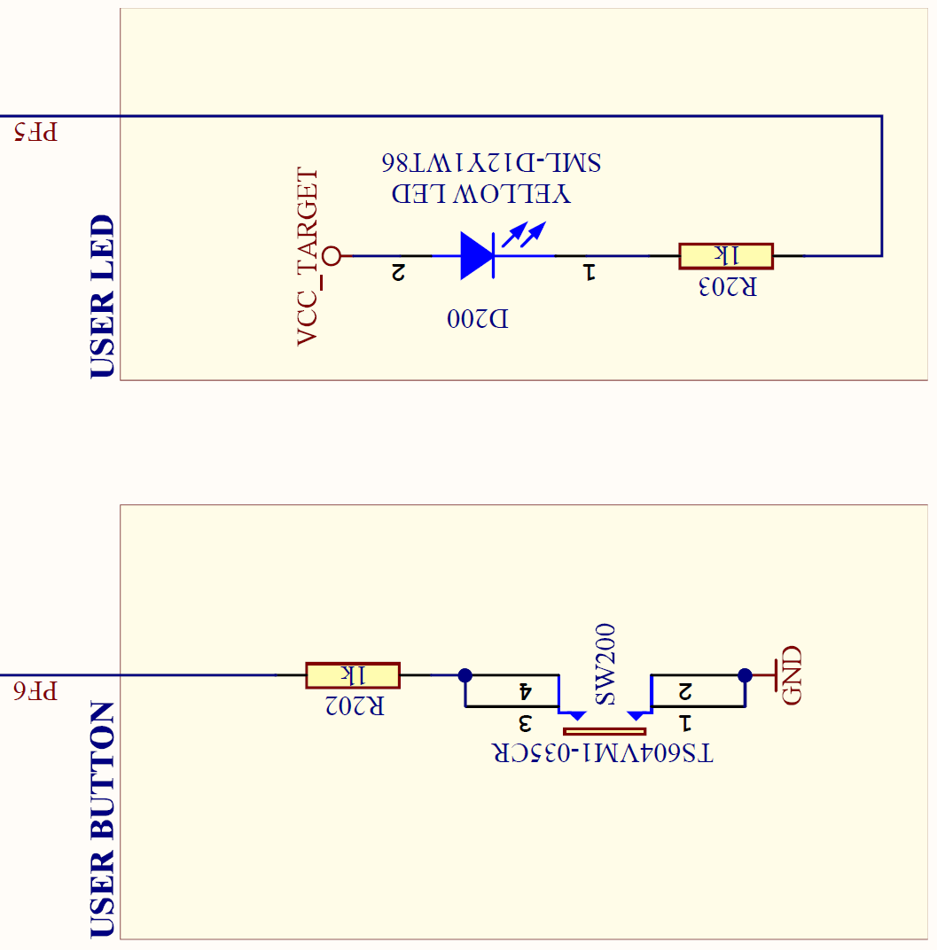
Hardware
User Guide

Slide 72
AVR I/O - Output
Controlled by the MCU
  0 == GND, 1 == VCC
  Example: LEDs
    «Active High» or «Active Low»
AVR Pin
VCC
GND
AVR Pin

Slide 73
AVR I/O - Output
Controlled by the MCU
  Pin = 0 == GND
  Example: LEDs
    «Active High» or «Active Low»
AVR Pin = GND
VCC
Pin = 0
0 V
3.3 V
No current
Current flow
GND
AVR Pin = GND

Slide 74
AVR I/O - Output
Controlled by the MCU
  Pin = 1 == VCC
  Example: LEDs
    «Active High» or «Active Low»
AVR Pin = VCC
VCC
Pin = 1
3.3 V
0 V
Current flow
No current
GND
AVR Pin = VCC

Slide 75
AVR I/O - Output
Controlled by the MCU
  0 == GND, 1 == VCC
  Example: LEDs
    «Active High» or «Active Low»
AVR Pin
VCC
GND
AVR Pin

Slide 76
AVR I/O - Input
Controlled externally
  Floating - Undefined state when not connected
  0 ~= GND, 1 ~= VCC
  The pin voltage needs to be «pulled» to 0 or 1
AVR Pin = Floating
? V
GND

Slide 77
AVR I/O - Input
Controlled externally
  Floating - Undefined state when not connected
  0 ~= GND, 1 ~= VCC
  The pin voltage needs to be «pulled» to 0 or 1
AVR Pin = GND
0 V
GND

Slide 78
AVR I/O - Input
Example: Switches
  Pull-up
VCC
AVR Pin
GND

Slide 79
AVR I/O - Input
Example: Switches
  Pull-up
VCC
0 V, as pin voltage is pulled up
AVR Pin = VCC
3.3 V
GND

Slide 80
AVR I/O - Input
Example: Switches
  Pull-up - Active Low
VCC
3.3 V
AVR Pin = GND
0 V, as pin voltage is pulled down hard
GND

Slide 81
AVR I/O - Input
Example: Switches
  Pull-up - Active Low
VCC
3.3 V, still trying to pull up,
current limited by resistor
AVR Pin = GND
0 V, as pin voltage is pulled down hard
no limitation on current
GND

Slide 82
AVR I/O - Input
Example: Switches
  Pull-down - Active High
  Same same, only inverted
VCC
AVR Pin
GND

Slide 83
AVR I/O - Input
Example: Switches
  Pull-down - Active High
  Same same, only inverted
VCC
AVR Pin
GND

Slide 84
Time to play!
https://omegav.no/avrkurs
OV people provide support
Microchip people support the support

Slide 85
Time to play!
https://omegav.no/avrkurs
MPLAB X IDE: Open the .X folder
  Each task is a configuration in the project
Microchip Studio: Open the *.atsln file
  One project for each task

Slide 86
Unexpected info!

Slide 87
Bit-fu 3rd Dan
http://realtimecollisiondetection.net/blog/?p=78

Slide 88
The three next slides are to be presented 1-2 hours into the hands-on tasks,
if we are confident the bitshifting has been understood..

Slide 89
Some tips to simplify stuff
Egil will talk a bit more at 20:00

Slide 90
Bitmasks again
In the header file:
How I would write it:
        #define PIN3_bp 3
        #define PIN3_bm (1 << PIN3_bp)
        PORTA.OUT = PIN3_bm;
        USART.CTRLB = USART_TXEN_bm;
        PORTA.PIN2CTRL = PORT_ISC_LEVEL_gc;

Slide 91
Bitmasks again
In the header file:
How I would write it:
Named settings in header file:
(Not valid for ATmega328 and other old devices)
        #define PIN3_bp 3
        #define PIN3_bm 0x08
        PORTA.OUT = PIN3_bm;
        USART.CTRLB = USART_TXEN_bm;
        PORTA.PIN2CTRL = PORT_ISC_LEVEL_gc;
Notes:
_bm vs _gc

Slide 92
Making GPIO life easier
We have added PORT registers that does set, clear and toggling for you!
DO NOT USE |= OR &= OR ^= HERE
        PORTA.OUTSET = PIN3_bm;
        PORTA.OUTTGL = PIN7_bm;
        PORTA.OUTCLR = PIN3_bm;

Slide 93
Correct Read-Modify-Write
The Control C register was configured like this:
We want to change reference from VDD to VREFA
Can be combined into one line
Or just reconfigure all the bitfields
ADC0.CTRLC = ADC_REFSEL_VDDREF_gc | ADC_PRESC_DIV128_gc;
ADC0.CTRLC &= ~ADC_REFSEL_gm;
ADC0.CTRLC |= ADC_REFSEL_VREFA_gc;
ADC0.CTRLC = (ADC0.CTRLC & ~ADC_REFSEL_gm) | ADC_REFSEL_VREFA_gc;
ADC0.CTRLC = ADC_REFSEL_VREFA_gc | ADC_PRESC_DIV128_gc;

Slide 94
Correct Read-Modify-Write – Compiled
18e:e0 e0 ldi r30, 0x00 ; Address to ADC0 struct (Z-pointer low byte)
190:f6 e0 ldi r31, 0x06 ; Address to ADC0 struct (Z-pointer high byte)
ADC0.CTRLC &= ~ADC_REFSEL_gm;
196:82 81 ldd r24, Z+2 ; Load ADC0.CTRLC into r24 (byte 2 in ADC0 struct)
198:8f 7c andi r24, 0xCF ; r24 &= ~ADC_REFSEL_gm
19a:82 83 std Z+2, r24 ; Load r24 into ADC0.CTRLC
ADC0.CTRLC |= ADC_REFSEL_VREFA_gc;
19c:82 81 ldd r24, Z+2 ; Load ADC0.CTRLC into r24
19e:80 62 ori r24, 0x20 ; r24 |= ADC_REFSEL_VREFA_gc
1a0:82 83 std Z+2, r24 ; Load r24 into ADC0.CTRLC
ADC0.CTRLC = (ADC0.CTRLC & ~ADC_REFSEL_gm) | ADC_REFSEL_VREFA_gc;
1a2:82 81 ldd r24, Z+2 ; Load ADC0.CTRLC into r24
1a4:8f 7c andi r24, 0xCF ; r24 &= ~ADC_REFSEL_gm
1a6:80 62 ori r24, 0x20 ; r24 |= ADC_REFSEL_VREFA_gc
1a8:82 83 std Z+2, r24 ; Load r24 into ADC0.CTRLC
ADC0.CTRLC = ADC_REFSEL_VREFA_gc | ADC_PRESC_DIV128_gc;
1aa:86 e2 ldi r24, 0x26 ; Hex value of ADC_REFSEL_VREFA_gc | ADC_PRESC_DIV128_gc
1ac:82 83 std Z+2, r24 ; Load r24 into ADC0.CTRLC

Slide 95
Thank You, Microchip leaves at 21:00 ☺
Two hands in the air if you want merch in the mean time

